Slide 1
Neural Discrete Representation Learning
Aaron van den Oord, Oriol Vinyals, Koray Kavukcuoglu

Slide 2
Motivation
Discovery of a discrete intermediate representation
Learn a meaningful structure of the data
Match data to “prototypes”
Model important aspects of the data
Why discrete?
Many aspects of real world data can be discrete

Slide 3
Evidence for Human Learning of Discrete Concepts
Tyler, Lorraine K., and Helen E. Moss. "Towards a distributed account of conceptual knowledge." Trends in cognitive sciences 5.6 (2001): 244-252.
VanRullen, Rufin, and Christof Koch. "Is perception discrete or continuous?." Trends in cognitive sciences 7.5 (2003): 207-213.
Pulvermüller, Friedemann. "Brain embodiment of syntax and grammar: Discrete combinatorial mechanisms spelt out in neuronal circuits." Brain and language 112.3 (2010): 167-179.
Hamann, Stephan. "Mapping discrete and dimensional emotions onto the brain: controversies and consensus." Trends in cognitive sciences 16.9 (2012): 458-466.

Slide 4
Traditional approaches
PCA, ICA, TSNE, etc. etc. etc.
Fails when the data is very complex, or very high dimensional
Adversarial based
Can miss modes in the data
Variational Auto Encoders
Can suffer from posterior collapse (Encoder-Decoder, but decoder ignores latent)
Variational GAN
Also a popular approach (but not discrete)

Slide 5
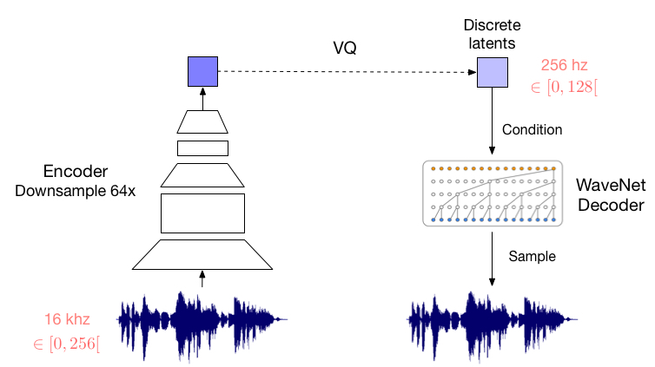
Vector Quantization

Slide 6
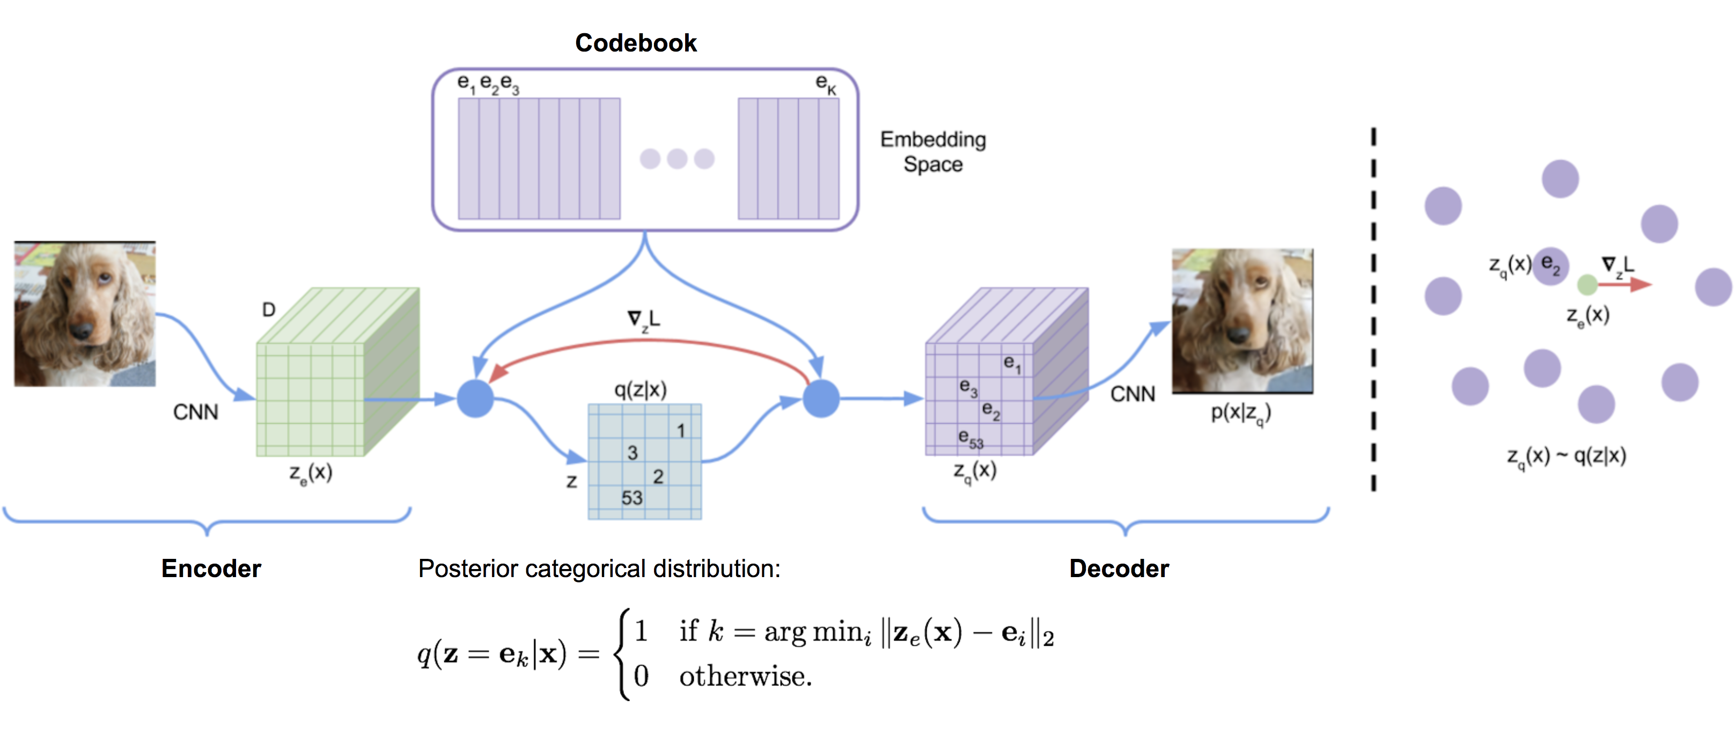
Closer look at Vector Quantization
Initialize a codebook with K random vectors each of size 1 x D
Let the encoder produce a set of H x W continuous latents, each of size 1 x D
Map each vector to the closest one in the codebook
Decode the H x W into an image

Slide 7
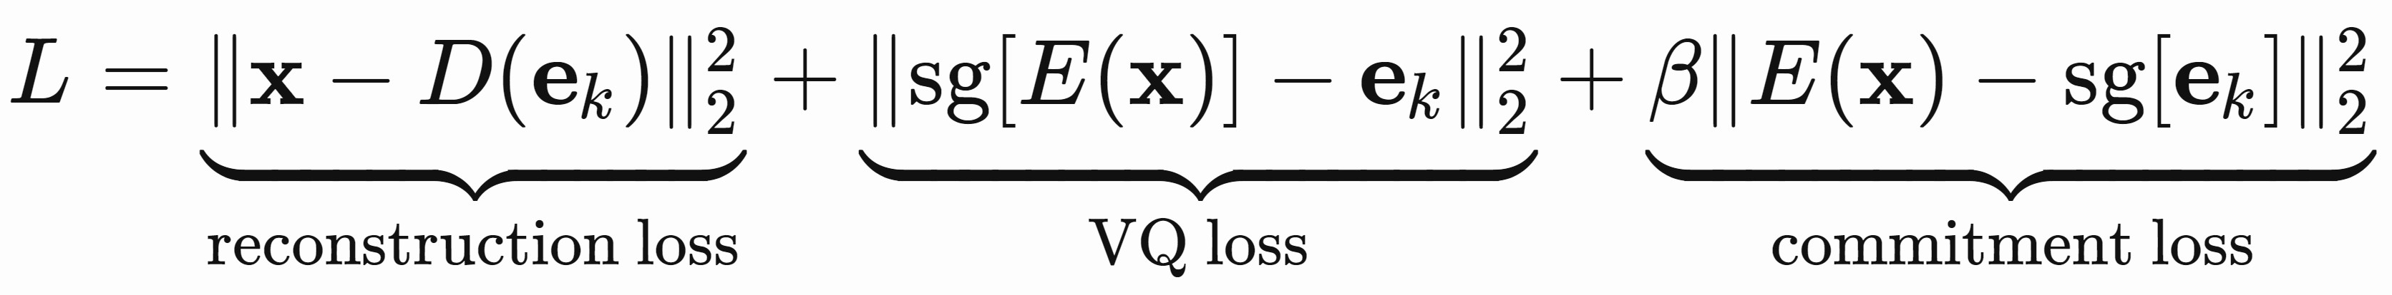
Constraints
You cannot compute a gradient with respect to a discrete nearest neighbor operation
They simply copy the feedback (gradient) from the codebook

Slide 8
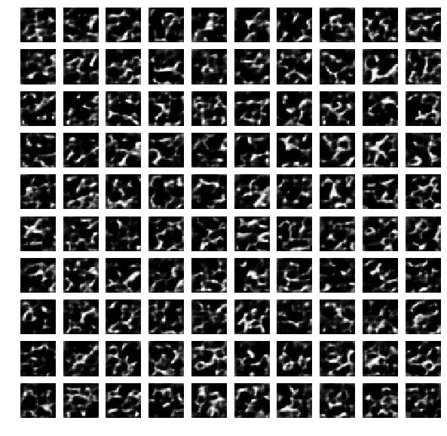
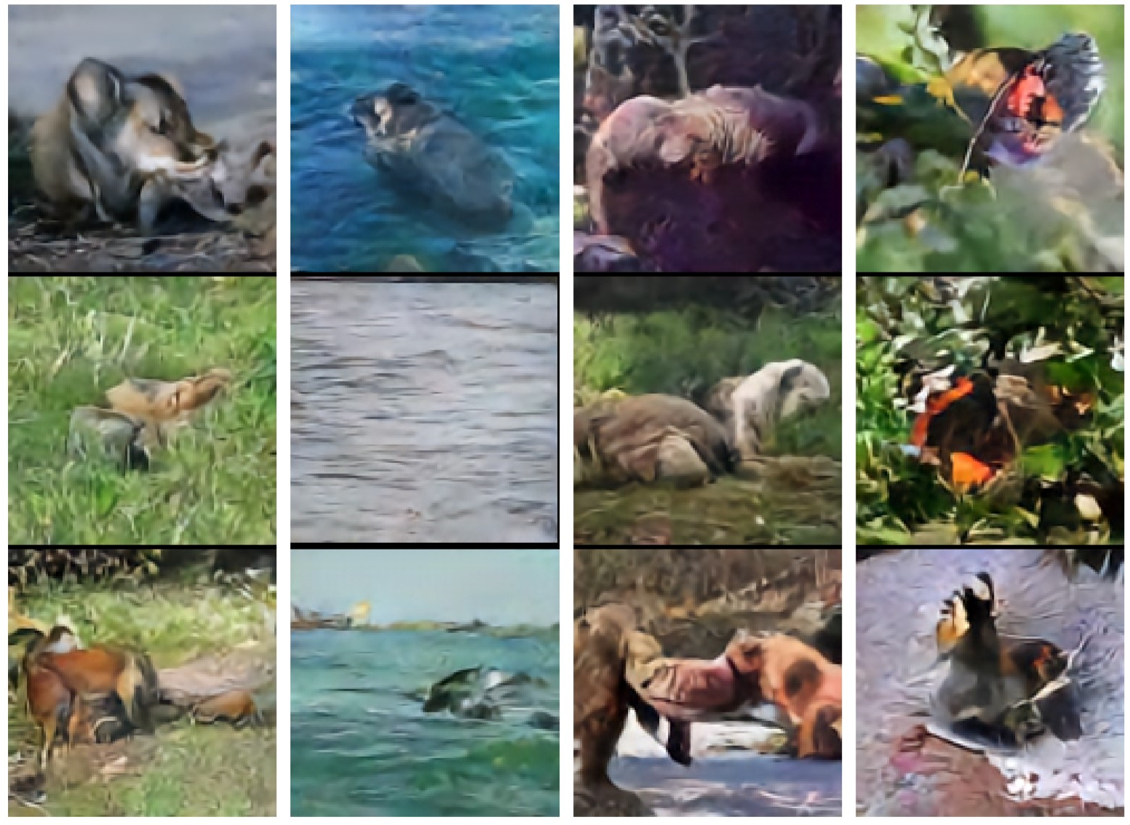
Results

Slide 9
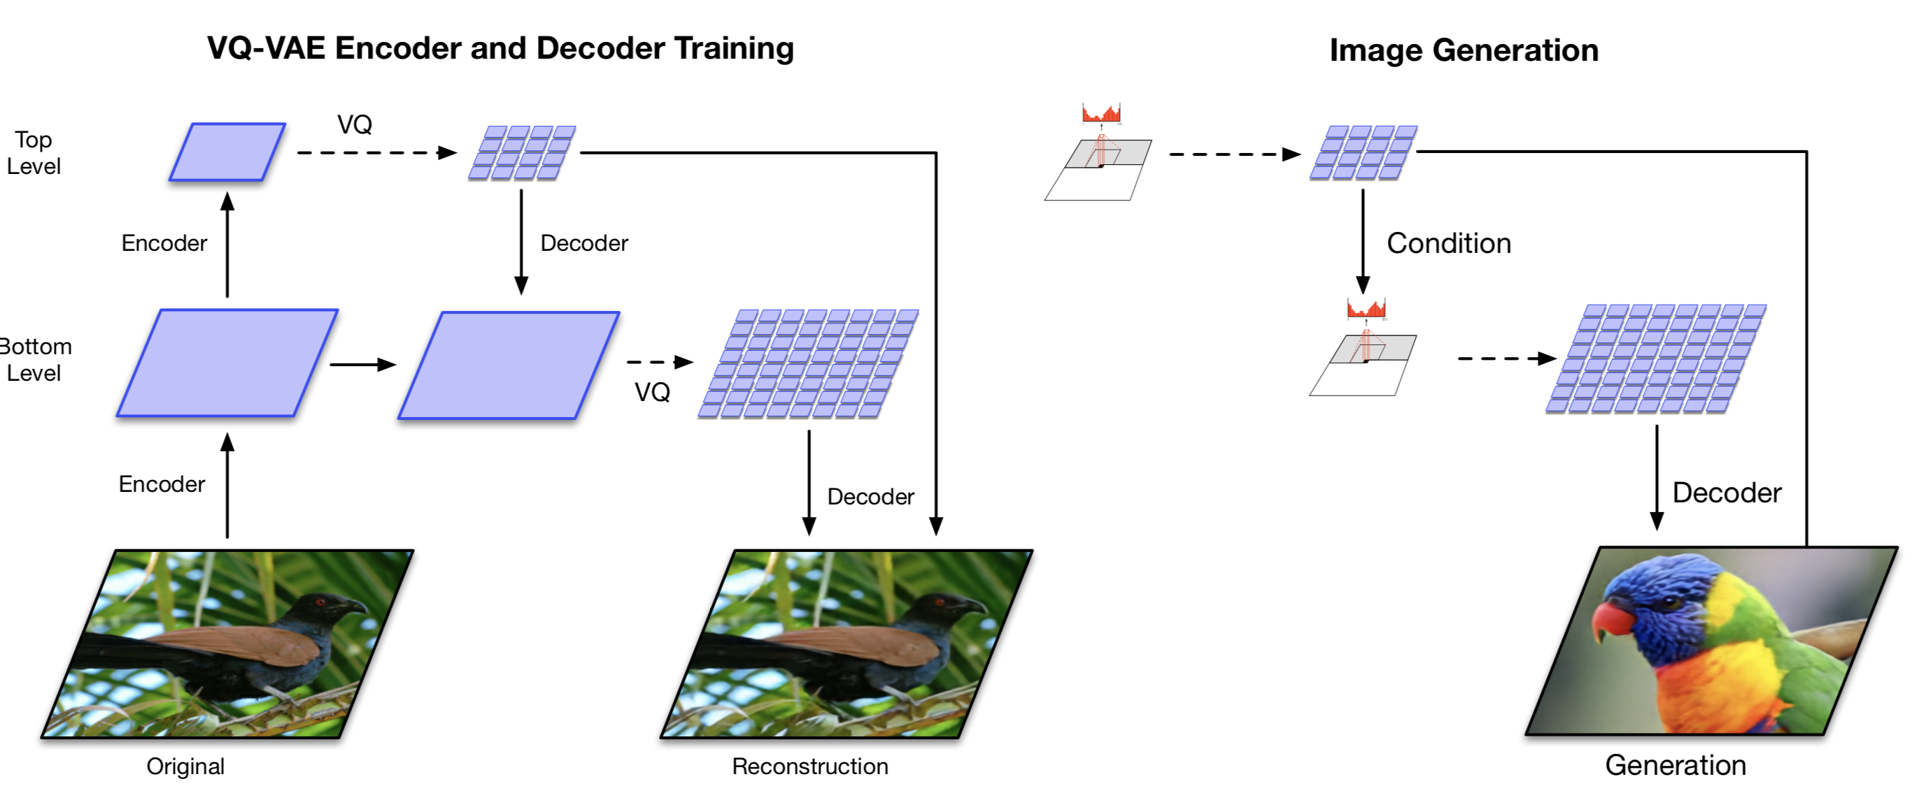
VQ-VAE-2

Slide 10
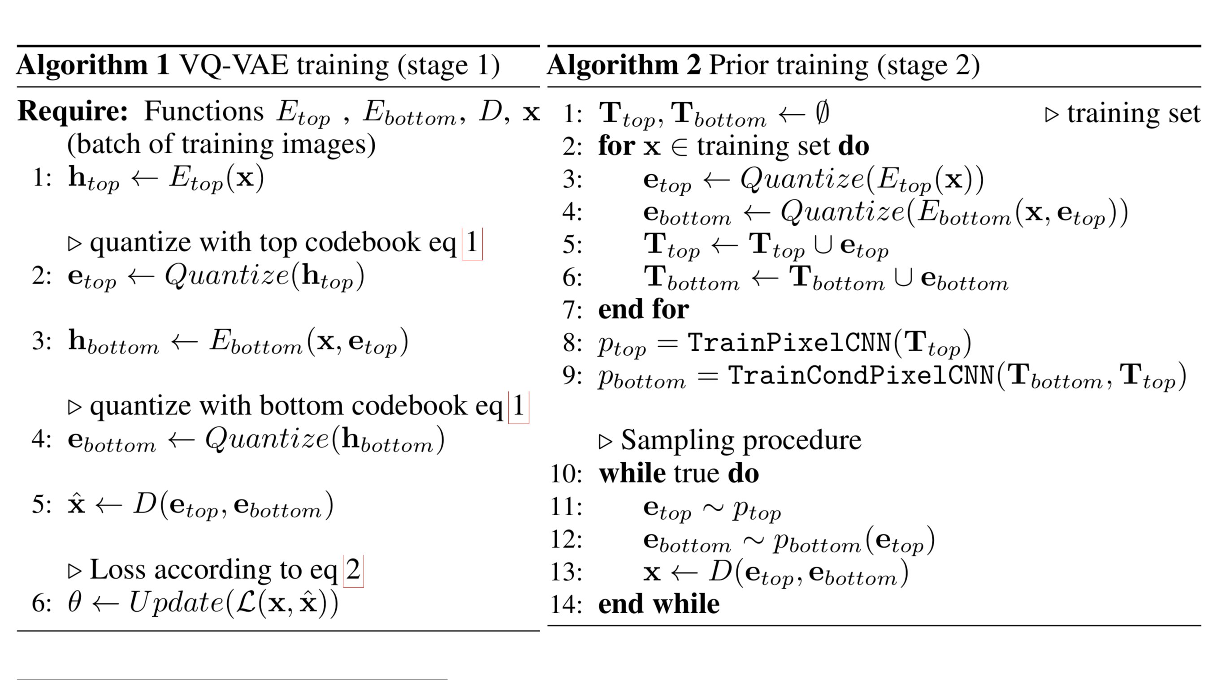
Hierarchical Discrete Latents

Slide 11
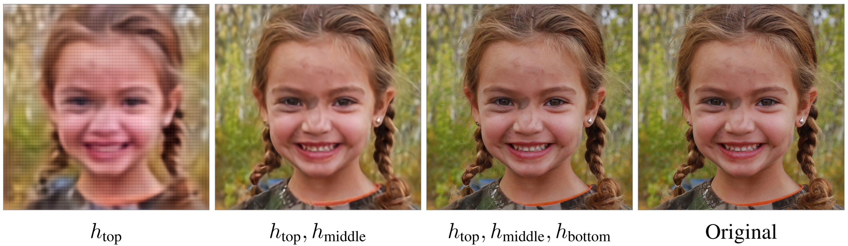
VQ-VAE-2 (reconstruction)

Slide 12
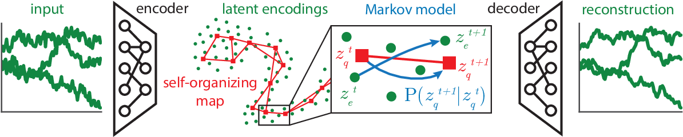
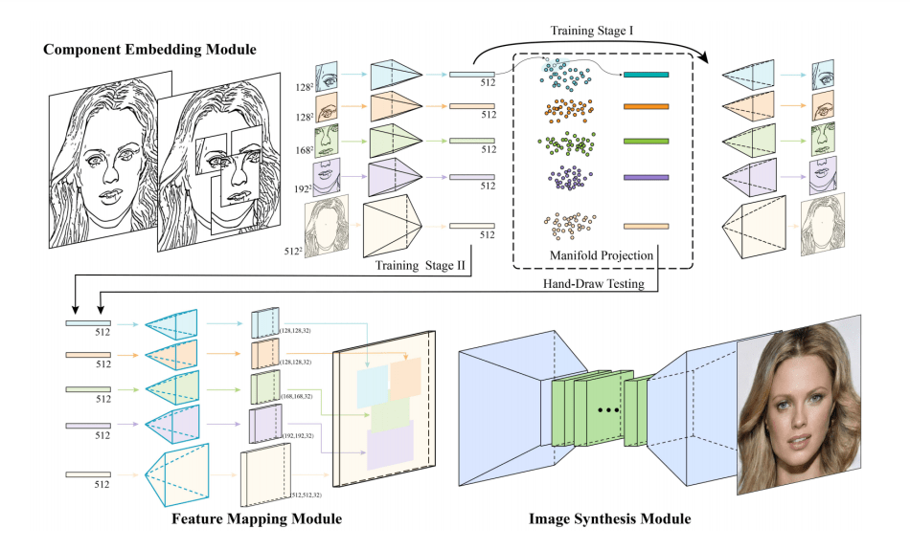
Related Work
SOM-VAE: Interpretable Discrete Representation Learning on Time Series
DeepFaceDrawing: Deep Generation of Face Images from Sketches

